Slide 1

MOHD RAHIL

Slide 2
INTRODUCTION
"Atliq Grands, a renowned name in luxury hospitality, has faced challenges in recent years, leading to a decline in market share and revenue. To counter this, the company is embracing the power of Business and Data Intelligence. This presentation outlines our strategic approach to harnessing insights from historical data to drive recovery and regain our competitive edge."

Slide 3
Project Details
Project Title | Atliq Hospitality Analysis
Technologies | Data Science
Domain | Travel and Tourism
Tool | Power BI

Slide 4
Problem Statement
Atliq Grands owns multiple five-star hotels across India. They have been in the hospitality industry for the past 20 years. Due to strategic moves from other competitors and ineffective decision-making in management, Atliq Grands are losing its market share and revenue in the luxury/business hotels category. As a strategic move, the managing director of Atliq Grands wanted to incorporate “Business and Data Intelligence” in order to regain their market share and revenue. However, they do not have an in-house data analytics team to provide them with these insights. Their revenue management team had decided to hire a 3rd party service provider to provide them with insights from their historical data.

Slide 5
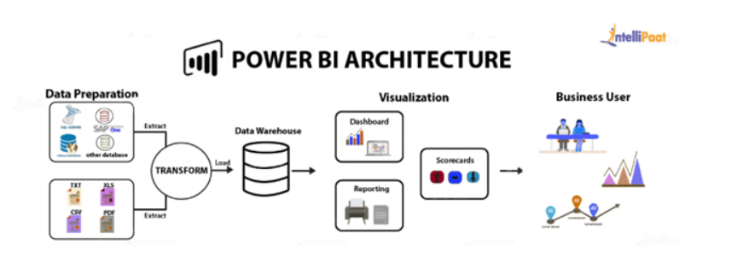
Architecture

Slide 6
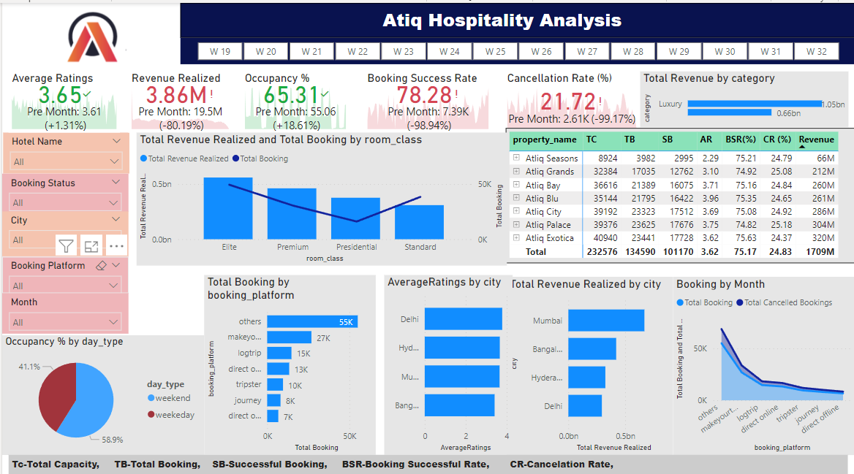
My Dashboard
Overview Analysis

Slide 7
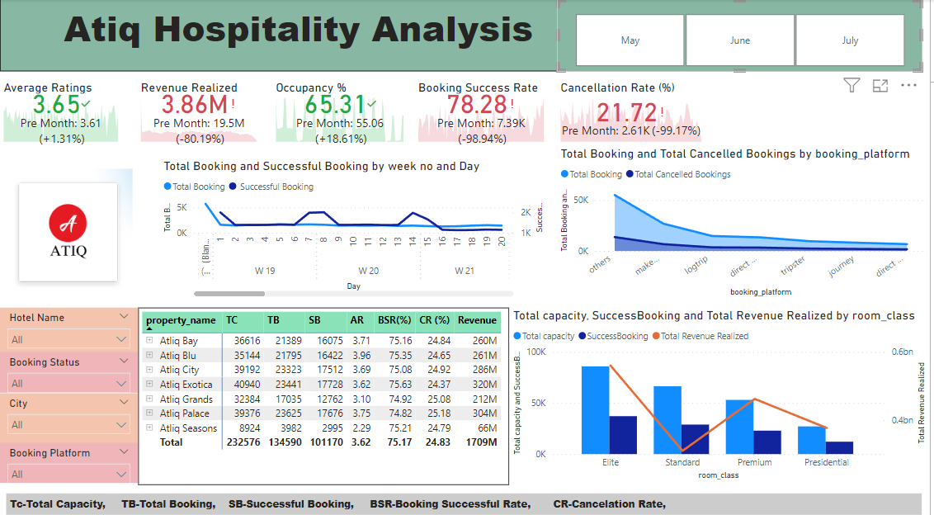
Monthly Analysis

Slide 8
Thank You
MOHD RAHIL

